Slide 1
BFSI - Risk Analysis

Slide 2
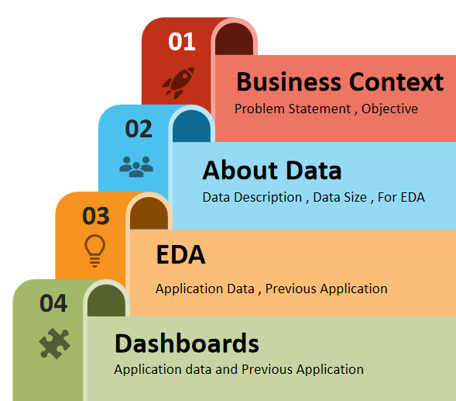
Agenda

Slide 3
Business Context
Problem Statement -
In the banking and financial services industry, managing the risk associated with lending is crucial. Lenders must evaluate the likelihood that a borrower will default on their loan, as defaults can result in significant financial losses. The goal is to identify patterns that indicate a higher risk of default, which can inform actions such as denying the loan, reducing the loan amount, or charging higher interest rates to risky applicants. By doing so, lenders can better ensure that only creditworthy consumers receive loans.
Objective -
The objective of this analysis is to apply exploratory data analysis (EDA) and predictive modelling to identify key factors contributing to loan defaults. By examining borrower demographics, financial history, and loan details, we aim to uncover insights that enhance risk assessment and support better lending strategies to reduce defaults and improve profitability.

Slide 4
About Data
Data Description-
1. application_data.csv It contains all the information of the client at the time of application. The data is about whether a client has payment difficulties.
2. previous_application.csv It contains information about the client’s previous loan data. It contains the data whether the previous application had been Approved, Cancelled, Refused or Unused offer.
Data Size -
1. application_data.csv It contain about 122 columns and 307511 records.
2. previous_application.csv It contain about 37 columns and 1670214 records.
For exploratory data analysis (EDA) -
From both application_data.csv and previous_application.csv ignoring all the columns where null value percentage is greater than 40%

Slide 5

Exploratory Data Analysis (EDA)

Slide 6

Analysis On Application Data

Slide 7
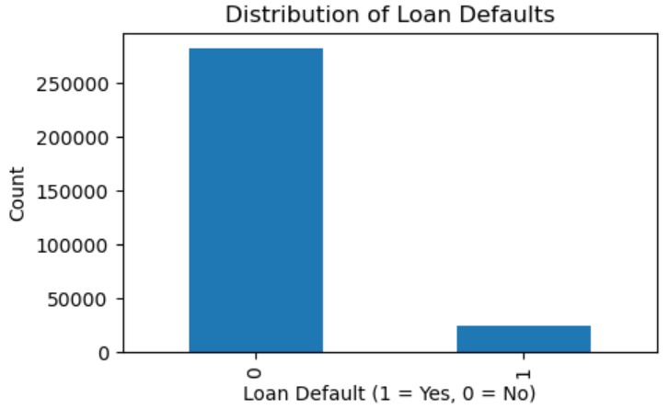
Distribution of loan defaults
Class Imbalance:
Total Applications: 307,511
Non-Defaulting Borrowers (TARGET = 0): 282,686 (91.8%)
Defaulting Borrowers (TARGET = 1): 24,825 (8.2%)
Insight: Significant imbalance in class distribution; majority of applicants do not default.

Slide 8
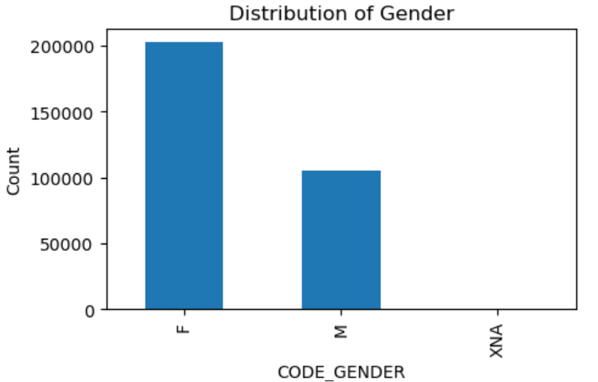
Gender Distribution
Gender Representation:
Female Borrowers (F): 202,448
(65.8%)
Male Borrowers (M): 105,059
(34.2%)
Unknown Gender (XNA): 4
(negligible)
Female Majority:
Insight: The dataset shows a
significant majority of female
borrowers, indicating
potential differences in
borrowing behavior or default
risk profiles compared to
male borrowers.

Slide 9
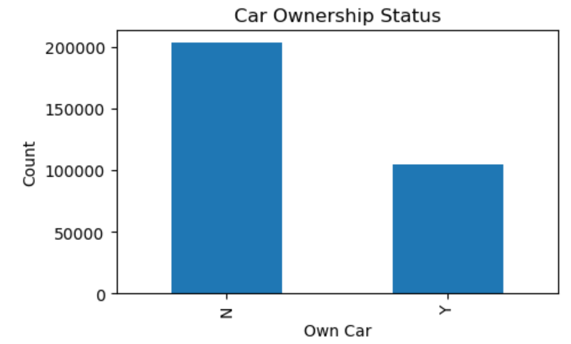
Car Ownership Status
Car Ownership Distribution:
Non-Car Owners (N): 202,924
(65.9%)
Car Owners (Y): 104,587 (34.1%)
Majority Without Car
Ownership:
Insight: A significant portion of
applicants do not own a car,
which may influence their
financial behaviors and
borrowing needs.

Slide 10
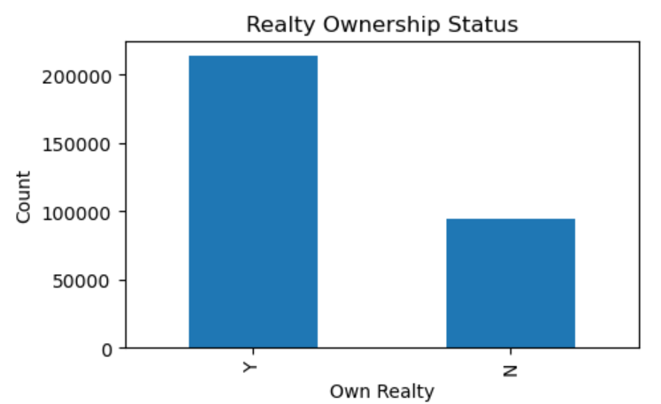
Realty Ownership Status
Realty Ownership Distribution:
Owners (Y): 213,312 (69.2%)
Non-Owners (N): 94,199 (30.8%)
Predominance of Realty
Owners:
Insight: A significant majority
of applicants own real estate,
suggesting potential stability
And a lower likelihood of
default.

Slide 11
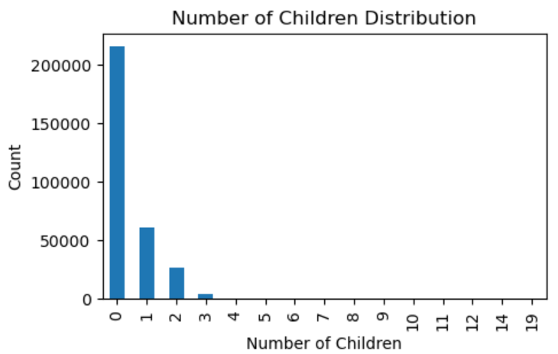
Number of Children Distribution
Children Count Distribution:
No Children (0): 215,371 (69.9%)
One Child (1): 61,119 (19.9%)
Two Children (2): 26,749 (8.7%)
Three Children (3): 3,717 (1.2%)
Four or More Children: 4
(negligible)
Majority Without Children:
Insight: A significant majority of
applicants (69.9%) do not have
children, which may affect their
financial responsibilities and
capacity to repay loans.

Slide 12
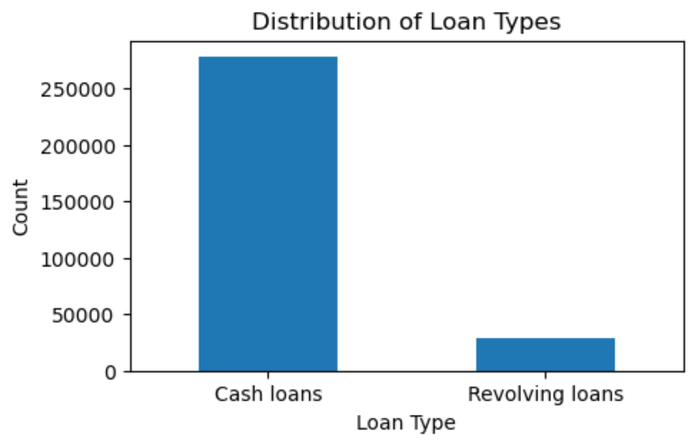
Distribution of Loan Types
Loan Type Distribution:
Cash Loans: 278,232 (90.4%)
Revolving Loans: 29,279 (9.6%)
Predominance of Cash Loans:
Insight: The overwhelming
majority of loan applications
are for cash loans, indicating
strong preference or need for
this type of financing among
borrowers.

Slide 13
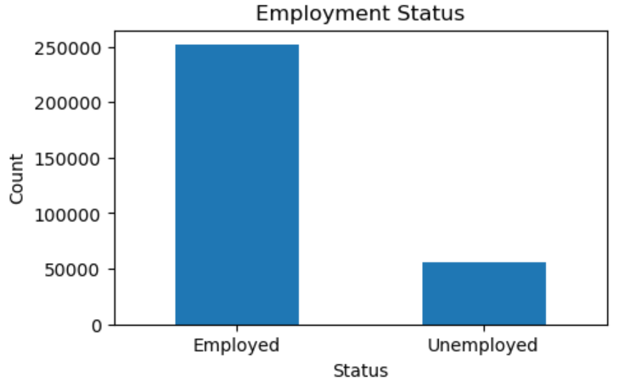
Employment Status
Employment Status Distribution:
Employed: 252,135 (81.1%)
Unemployed: 55,376 (18.9%)
High Employment Rate:
Insight: A significant majority
of loan applicants
are employed,
indicating a potentially more
stable financial situation and
capacity to repay loans.

Slide 14
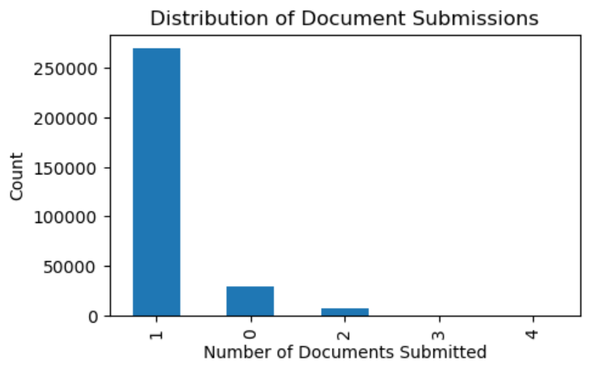
Distribution of Document Submissions
Document Submission Distribution:
1 Document Provided: 270,056 (89.4%)
No Documents Provided: 29,549 (9.8%)
2 Documents Provided: 7,742 (2.6%)
3 Documents Provided: 163 (0.1%)
4 Documents Provided: 1 (negligible)
Majority Submit Minimal Documentation:
Insight: A large portion of applicants (71%) only provides DOCUMENT_3, which may raise concerns regarding the completeness of their application and potential risk.

Slide 15
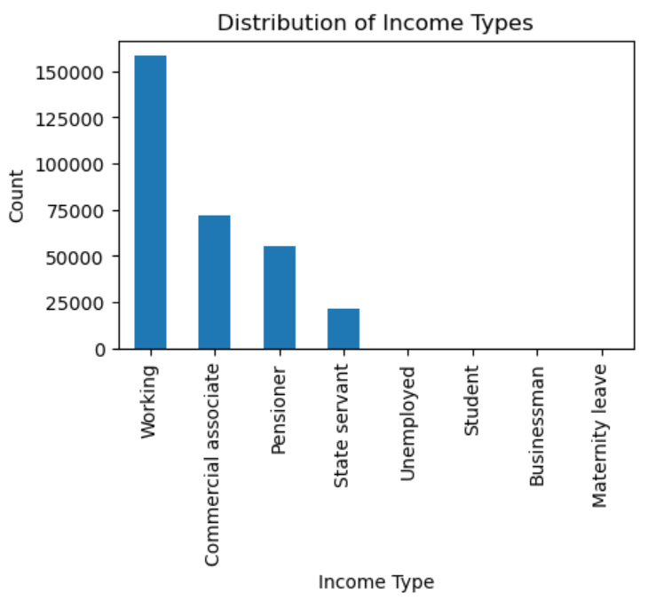
Distribution of Income Types
Income Type Distribution:
Working: 158,774 (51.3%)
Commercial Associate: 71,617
(23.3%)
Pensioner: 55,362 (18.0%)
State Servant: 21,703 (7.1%)
Predominance of Employment:
Insight: The majority of
applicants are employed,
highlighting a stable income
base that may contribute
positively to their
creditworthiness

Slide 16
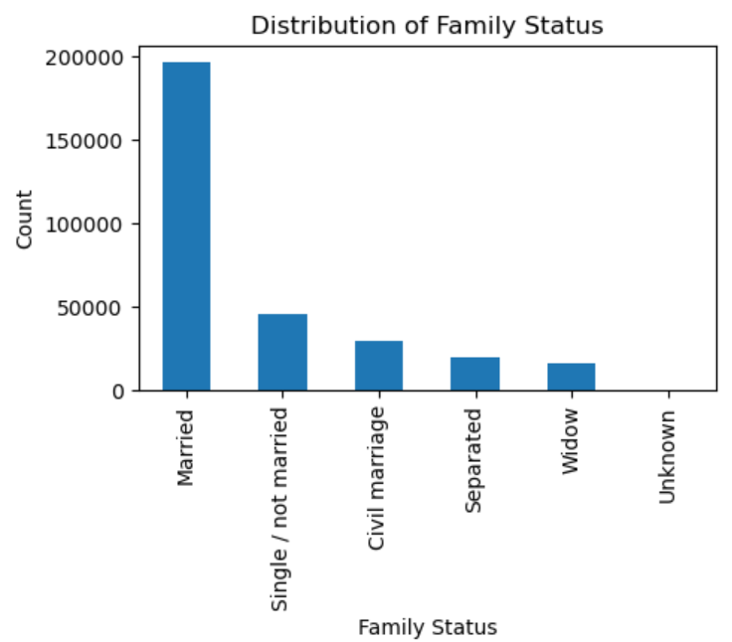
Distribution of Family Status
Family Status Distribution:
Married: 196,432 (64.1%)
Single / Not Married: 45,444
(14.8%)
Civil Marriage: 29,775 (9.7%)
Separated: 19,770 (6.5%)
Widow: 16,088 (5.2%)
Majority are Married:
Insight: A significant portion of
applicants are married, which
may correlate with greater
financial stability and
responsibility, potentially
impacting their loan repayment
behavior positively

Slide 17
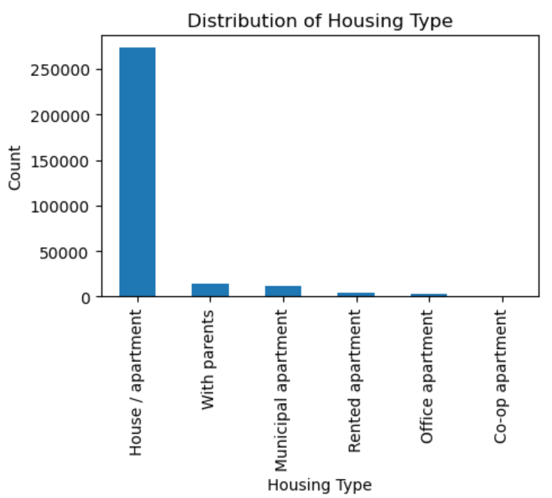
Distribution of Housing Type
Housing Type Distribution:
House / Apartment: 272,868 (85.8%)
With Parents: 14,840 (4.7%)
Municipal Apartment: 11,183 (3.5%)
Rented Apartment: 4,881 (1.5%)
Office Apartment: 2,617 (0.8%)
Co-op Apartment: 1,122 (0.4%)
Predominance of Home Ownership:
Insight: A significant majority of
applicants (85.8%) reside in their own
house or apartment, which often
indicates greater financial stability
and may correlate with lower default
rates.

Slide 18
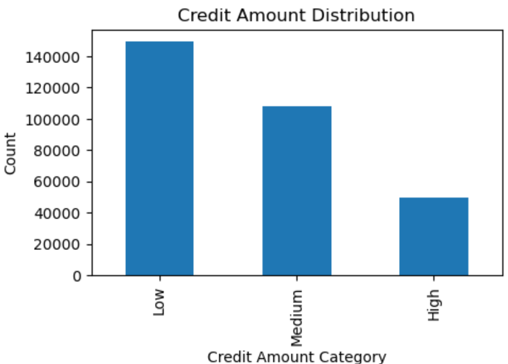
Credit Amount Distribution
Credit Amount Categories:
Low Credit Amount: 149,333 (57.6%)
Medium Credit Amount: 108,193
(41.4%)
High Credit Amount: 49,985 (1.0%)
Dominance of Low Credit Amounts:
Insight: The majority of applicants
(57.6%) are classified under low
credit amounts, indicating a
preference or need for smaller loan
sizes, possibly reflecting cautious
borrowing behavior or financial
constraints.

Slide 19
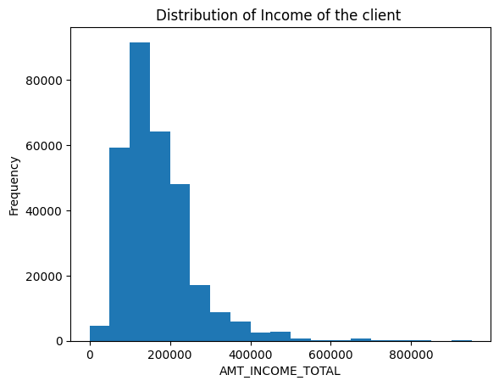
Income Distribution Among Clients
High Concentration of Low Incomes: Most clients have a total income between 0 and 200,000, with the highest frequency in this range.
Decrease with Higher Incomes: The frequency decreases as the income increases, indicating fewer clients with higher incomes.
Minimal High Incomes: Very few clients have an income above 600,000.

Slide 20
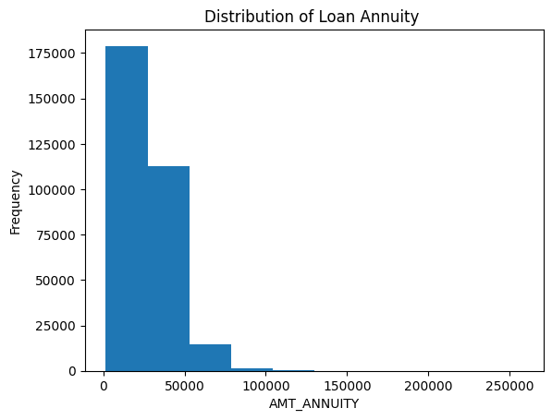
Loan Annuity Distribution Among Clients
Concentration of Low Annuities: Most loan annuities are concentrated between 0 and 50,000.
Steep Decline: There's a sharp decline in the frequency of annuities above 50,000.
Minimal High Annuities: Very few data points exist beyond 100,000.

Slide 21
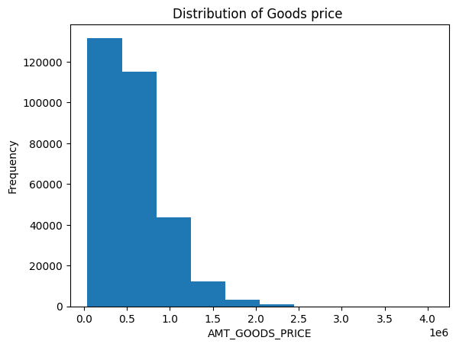
Goods Price Distribution
Clustered at Low Prices: The majority of goods are priced between 0 and 1,000,000.
Rapid Drop-Off: There's a noticeable decline in frequency as prices increase beyond 1,000,000.
Few High-Priced Goods: Very few goods are priced above 2,000,000.

Slide 22
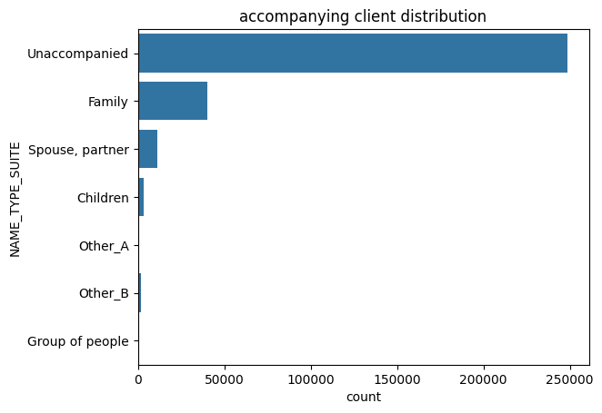
Accompanying Client Distribution
Majority Unaccompanied: Nearly 250,000 clients are unaccompanied.
Family Comes Second: Around 50,000 clients are accompanied by family.
Minimal Other Categories: Significant drop in numbers for spouse/partner (10,000), children (2,000), and others, with “Group of people” barely represented.

Slide 23
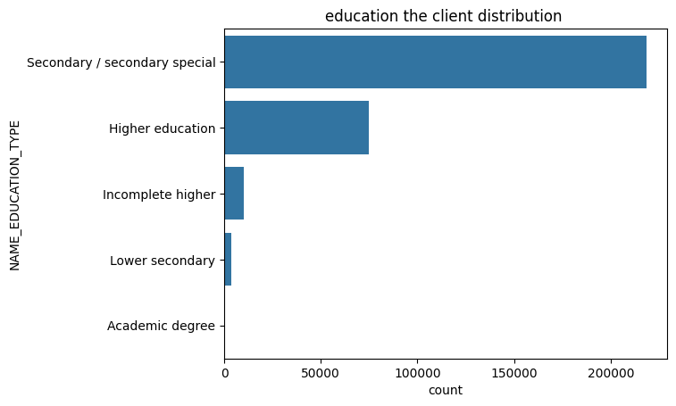
Education of Client Distribution
Dominance of Secondary Education: The vast majority of clients have a "Secondary / secondary special" education level, with over 200,000 clients.
Significant Higher Education Group: "Higher education" follows, with around 100,000 clients.
Few with Incomplete or Lower Secondary Education: Both "Incomplete higher" and "Lower secondary" education levels have significantly fewer clients, around 20,000 and slightly above 5,000 respectively.
Minimal Academic Degrees: Barely any clients hold an "Academic degree," the count being close to zero.

Slide 24
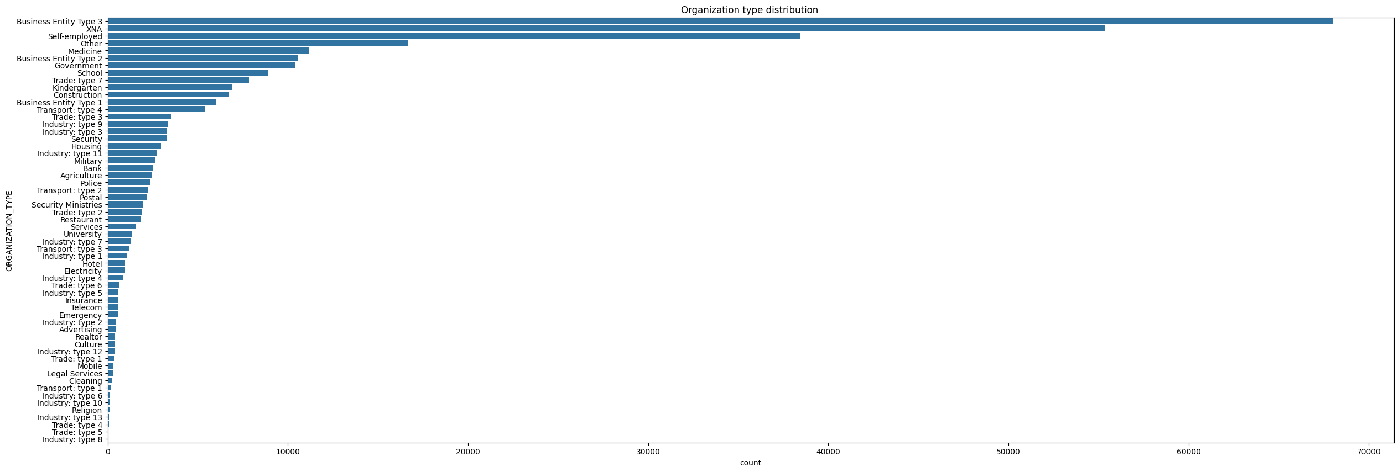
Organization Type Distribution
Dominance of Business Entity Type 3: It's the most common organization type, with a count approaching 70,000.
High Counts for Others: "Other" and "Self-employed" categories are also significant, each exceeding 40,000.
Drop in Counts: After the top three categories, there's a notable drop; "Medicine" and "Business Entity Type 2" count around 20,000.
Notes:
Long Tail Distribution: Many organization types have relatively low counts, such as "Industry: type 8" and "Trade: type 4," each below 2,000.
Diverse Representation: The chart showcases a wide range of organization types, from various "Business Entity" types to specific industries like "Telecom" and "Agriculture."

Slide 25
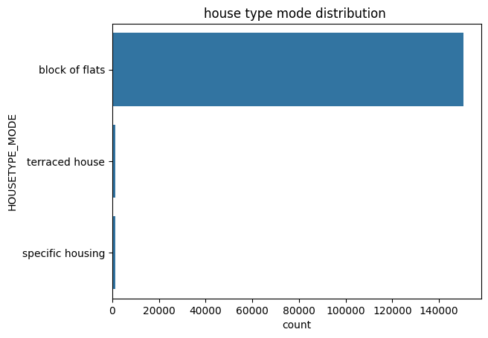
House Type Distribution
Predominance of Flats: The "Block of Flats" category towers above the others, making it the most common house type by a substantial margin.
Scarcity of Other Types: Both "Terraced House" and "Specific Housing" have minimal representation compared to "Block of Flats."
Clear Preference Trend: The data indicates a strong preference or prevalence for living in flats.

Slide 26
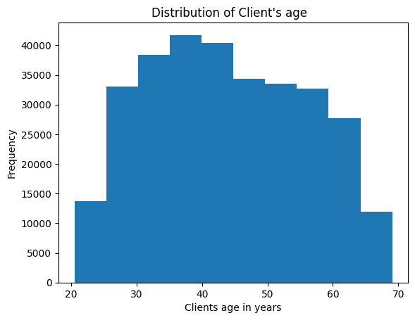
Client Age Distribution
Symmetrical Distribution: Clients’ ages, in days, are symmetrically distributed around the 40-year mark.
Peak at 40 Years: The highest frequency of clients occurs at around 40 year of age.
Balanced Tapering: The frequency of clients decreases evenly on both sides from the peak.

Slide 27
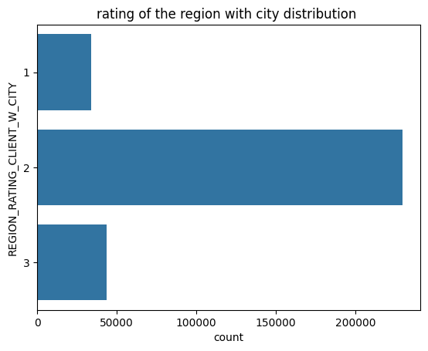
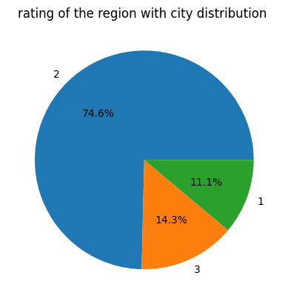
Rating of the Region City Distribution
Rating 2 Dominates: Rating 2 has the highest count, exceeding 200,000.
Significant Gap: Rating 3 follows but is much lower, a little above 50,000.
Rating 1 is Lowest: Rating 1 has the lowest count, slightly above 25,000.
Heavy Skew: The distribution is heavily skewed towards Rating 2, indicating most regions fall into this category.

Slide 28
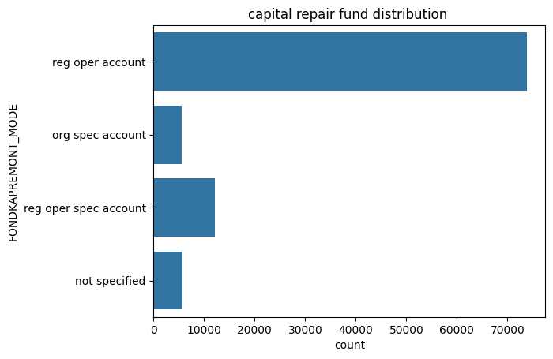
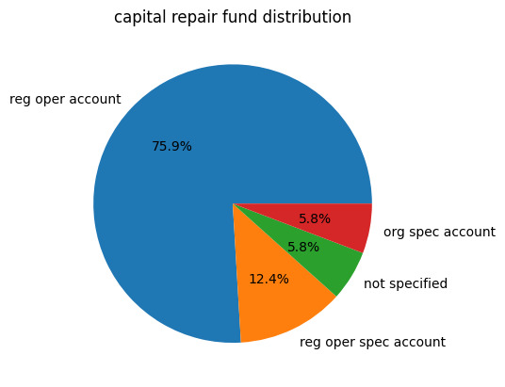
Capital Repair Fund Distribution
Dominance of 'Reg Oper Account': This mode has the highest count, approximately 70,000.
Moderate Counts for 'Org Spec Account' & 'Reg Oper Spec Account': They stand at around 10,000 and 15,000, respectively.
Lowest Count for 'Not Specified': This mode has the lowest count, around 5,000.

Slide 29
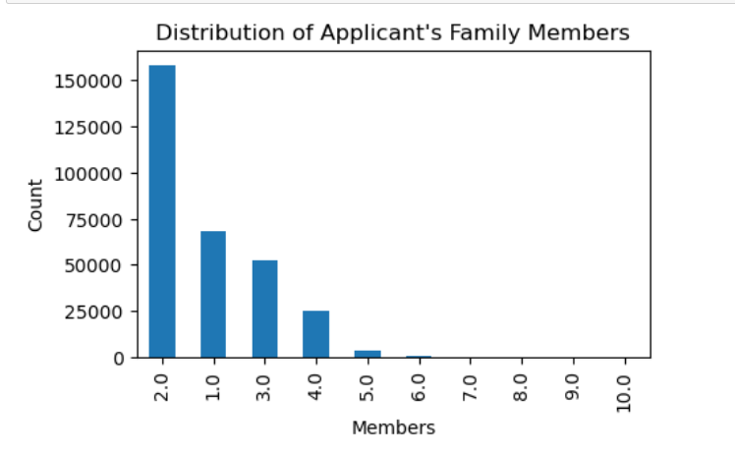
Applicant's Family Members Distribution
Most applicants have small Families: The majority of applicants have 2 family members 51%, followed by 1 family member 22% and 3 family members 17%.
Larger Families Are Less Common: Families with 4 or more members are much less frequent, with a significant drop
Very Large Families Are Rare: Families with 6 or more members are extremely rare, indicating that most applicants come from smaller family units.

Slide 30
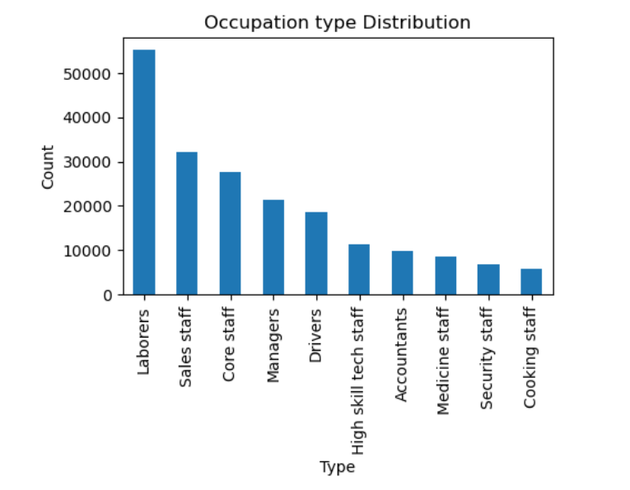
Occupation Type Distribution
Laborers are the most common occupation, with over 26% individuals.
Sales staff and Core staff follow as the second and third largest groups with 15% & 13%.
Managers and Drivers are moderately represented, each with significant percent.
High skill tech staff, Accountants, Medicine staff, Security staff , Cooking staff make up smaller portions, indicating these are less common occupations.

Slide 31
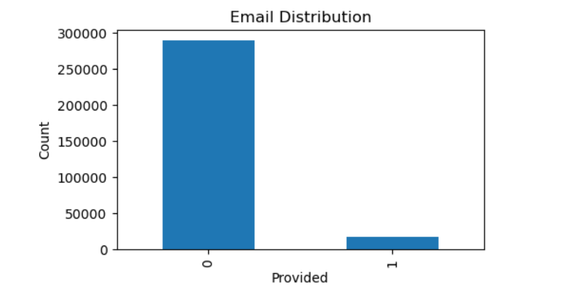
Applicant's Email Distribution
Majority Missing Emails: A large portion of the data shows that emails are not provided, with over 250,000 (94%) instances.
Few Emails Available: Only a small number of cases have emails provided (6%), indicating a limited collection of email contact information.

Slide 32
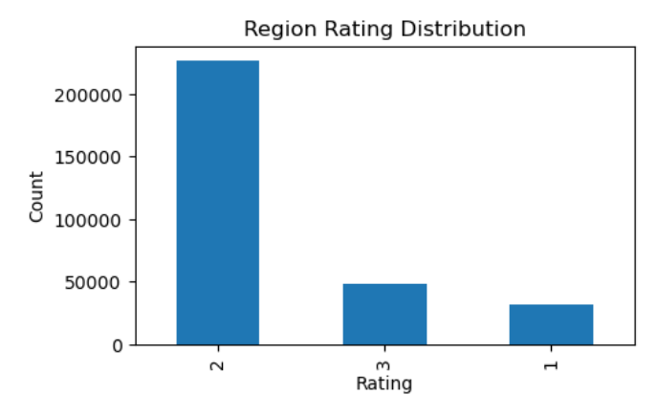
Region Rating Distribution
Most Regions Rated 2: The majority of regions with 74% have a rating of 2.
Moderate Count for Rating 3: A smaller group16% has a rating of 3,
Fewest Regions Rated 1: The lowest count of regions, under 10%, falls into the rating 1 category

Slide 33
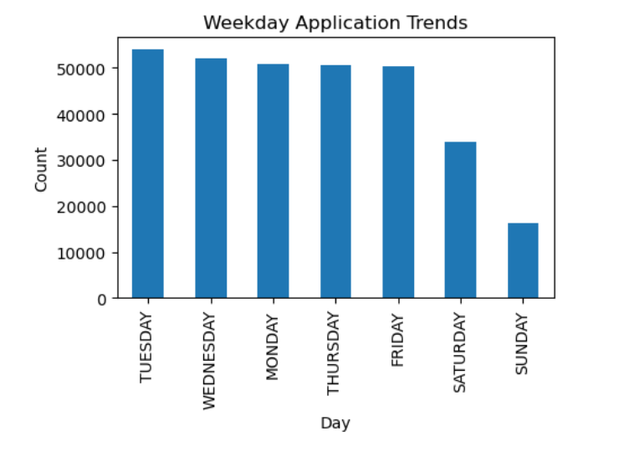
Weekday Application Trend
Weekday Trend:
Tuesday & Wednesday has the highest number of applications 18% each.
On Wednesday, Thursday and Friday, the number of applications is fairly consistent, 16% each.
Weekend Drop:
Saturday’s count is notably lower than the weekdays, at about 11%
Sunday has the lowest count, with applications dropping to 5%

Slide 34
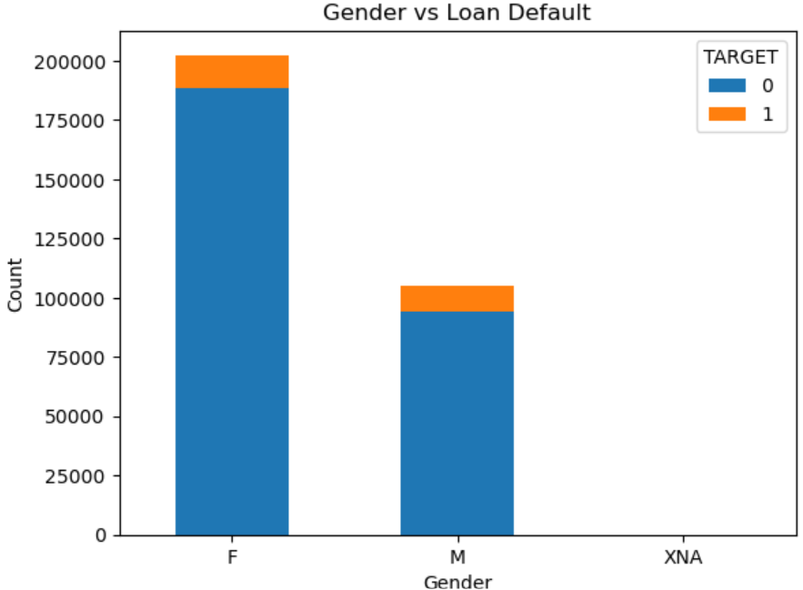
Gender vs Loan Default
Female Default Rate(1): 7.0%
Male Default Rate(1): 10.1%
Males exhibit a higher default rate compared to females, indicating that gender may be a factor in assessing loan repayment risk

Slide 35
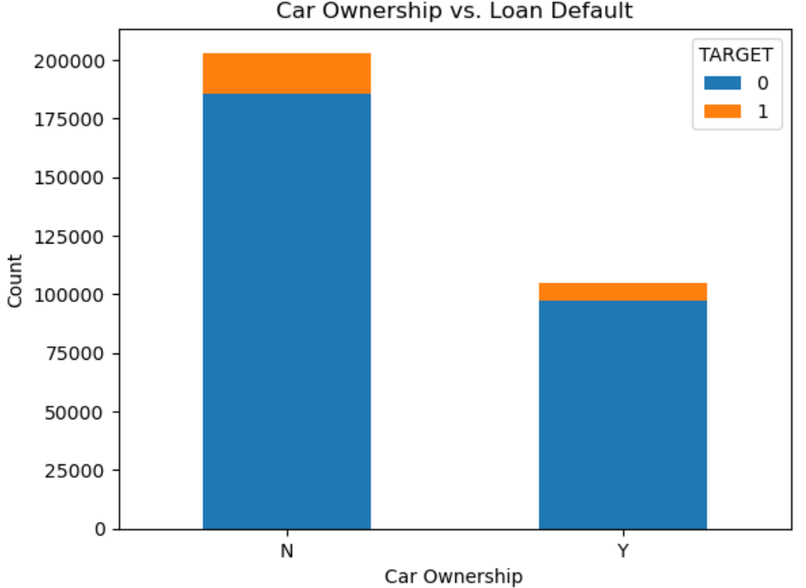
Car Ownership vs. Loan Default
No Car Default Rate(1): 8.5%
Car Ownership Default Rate(1): 7.2%
Borrowers who own a car have a slightly lower default rate compared to those who do not, suggesting that car ownership might be associated with more stable financial situations.

Slide 36
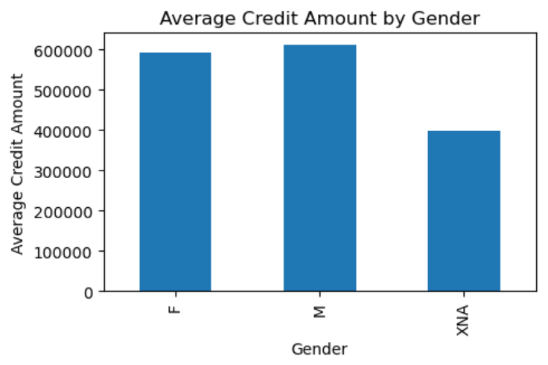
Average Credit Amount by Gender
Average Credit Amount:
Female Borrowers (F):
$592,766.72
Male Borrowers (M): $611,095.20
Unknown Gender (XNA):
$399,375.00
Gender Comparison:
Insight: Male borrowers receive
a higher average credit amount
compared to female borrowers,
with a difference of
approximately $18,328.48. This
may suggest different lending
behaviors or risk perceptions
between genders.

Slide 37
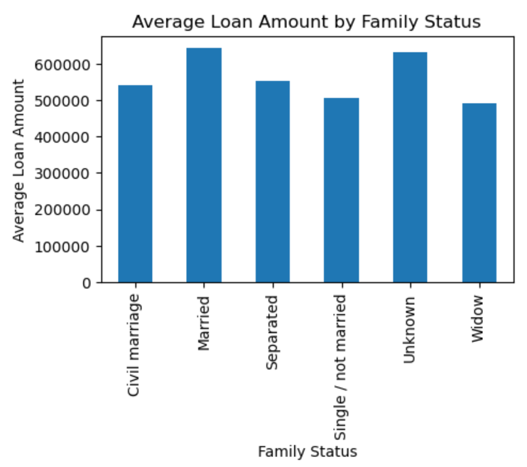
Average Loan Amount by Family Status
Average Loan Amounts by Family
Status:
Married: $642,999.79
Civil Marriage: $541,573.46
Separated: $552,113.82
Single / Not Married: $505,350.18
Widow: $490,695.91
Unknown: $630,000.00
Married Applicants Have the Highest Loan Amount:
Insight: Married applicants receive
the highest average loan amount,
suggesting they may be viewed as
lower risk due to potential dual
incomes and financial stability.

Slide 38
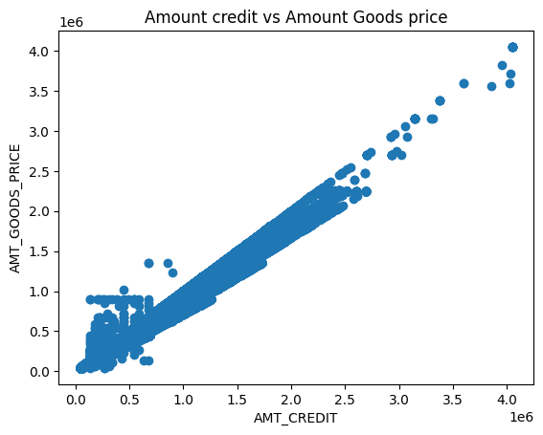
Amount Credit vs Amount Goods Price
Strong Positive Relationship: The amount of credit increases proportionally with the amount of goods price.
Dense Clustering at Lower Values: Most transactions occur at lower values of both credit and goods price.
Outliers Present: Some data points significantly deviate from the general trend, with goods prices either much lower or higher than the corresponding amount of credit.

Slide 39
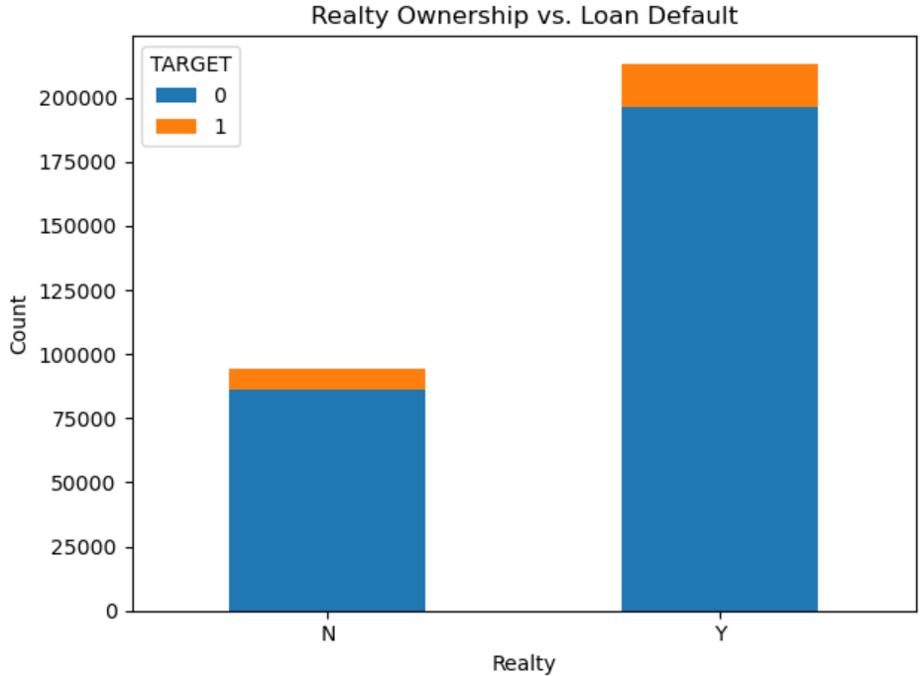
Realty Ownership vs. Loan Default
Clients who own realty (homes) have a lower default rate. Out of 196,329 homeowners, 16,983 defaulted (about 8.6%), compared to 7,842 defaults from 86,357 non-homeowners (about 9.1%).
Homeowners show a significantly higher number of non-defaults (196,329) compared to non-homeowners (86,357), indicating greater financial stability.

Slide 40
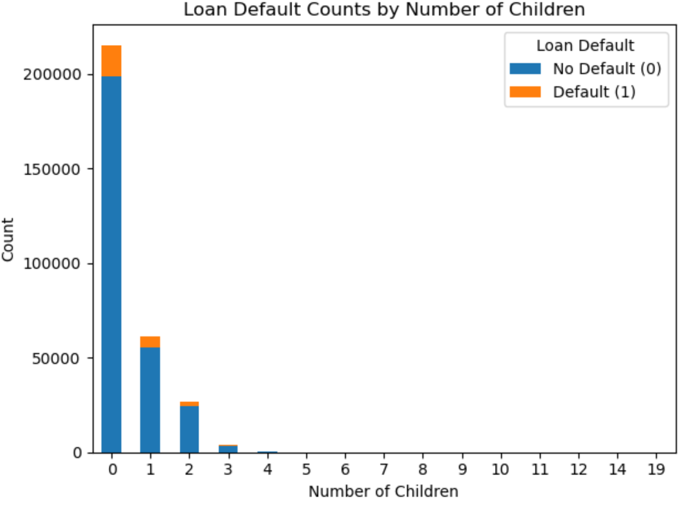
Number of Children vs. Loan Default
Clients with 0 children have a default rate of approximately 8.36%.
Clients with 1 child show a slightly higher default rate of around 9.80%.
This trend continues, with higher default rates observed for borrowers with 3 or more children (over 10% for 3 children).

Slide 41
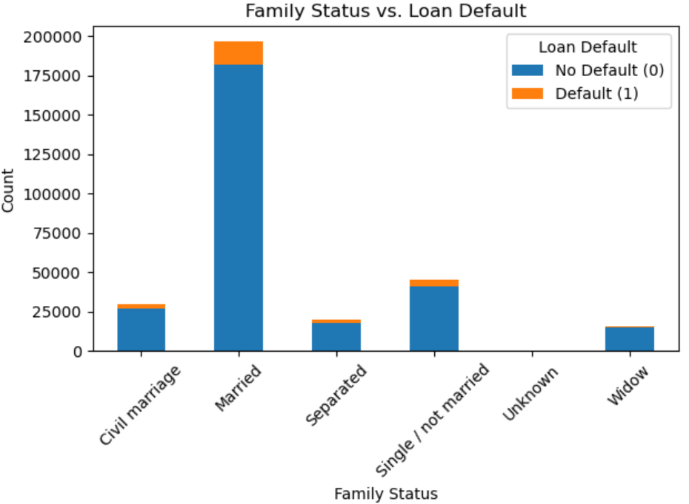
Family Status vs. Loan Default

Slide 42
Family Status vs. Loan Default
Married borrowers have the lowest default rate at about 7.6% (14,850 out of 181,582).
Civil marriage follows with a default rate of approximately 10% (2,961 out of 26,814).
Single/not married borrowers show a default rate of about 9.8% (4,457 out of 40,987).
Separated individuals have a higher default rate of around 8.2% (1,620 out of 18,150).
Widows also display a notable default rate of 6.2% (937 out of 15,151).

Slide 43
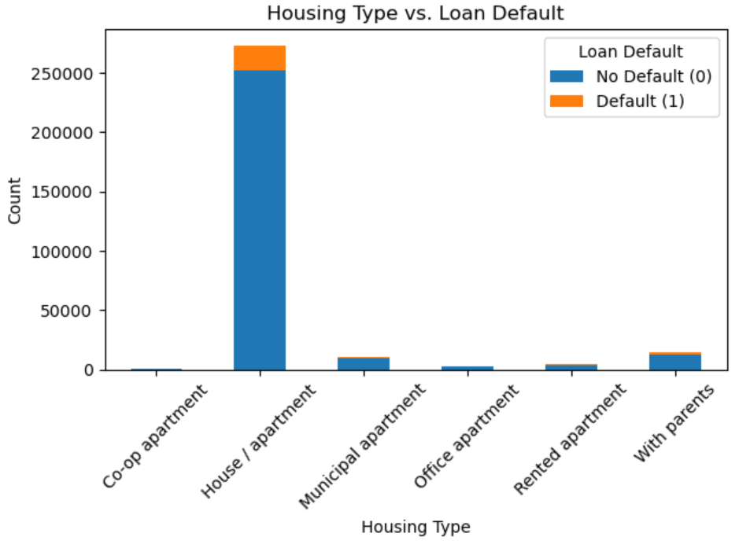
Housing Type vs. Loan Default
Higher Default Rates: Borrowers living with parents (13.23%) and in rented apartments (14.04%) show the highest default rates, indicating financial vulnerability.
Moderate Risk: Those in municipal apartments (9.34%) and co-op apartments (8.59%) also exhibit elevated default rates, though lower than renters and those living with parents.
Lower Default Rate: The house/apartment category has the largest number of borrowers but a more moderate default rate of 7.8, suggesting greater stability.

Slide 44
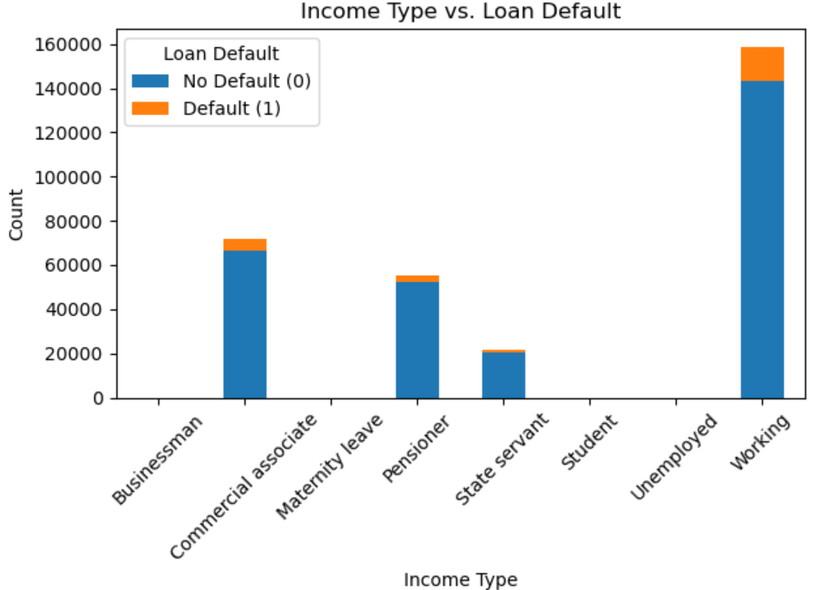
Income Type vs. Loan Default
Highest Risk: Unemployed borrowers have a default rate of 36.36%, indicating significant financial vulnerability.
Moderate Risk: Pensioners (5.38%) and state servants (6.11%) show moderate default rates, suggesting a potential risk.
Relatively Stable: Commercial associates have a default rate of 7.46%, while businessmen and students show minimal defaults due to low sample sizes.

Slide 45
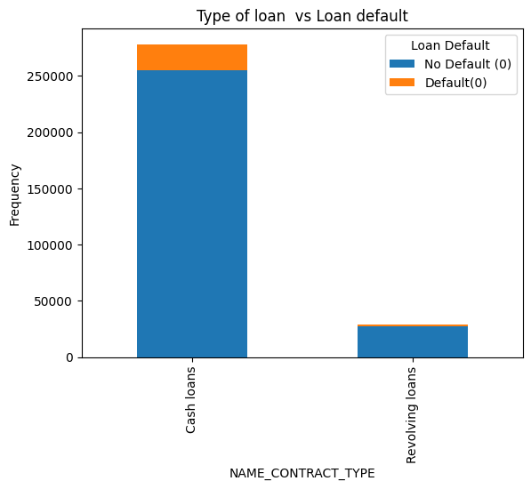
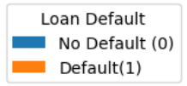
Type of Loan vs Loan Default
Overall, cash loans make up the vast majority of the loan data.
Default rate in cash loan is 8.34% and in revolving loan is 5.47%
Defaults are present in both loan types, but are more prominent in terms of volume in cash loans simply because there are many more of them.

Slide 46
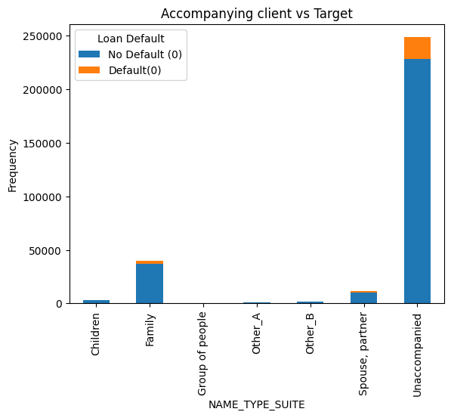
Accompanying Client vs Loan Default
Overall, unaccompanied make up the vast majority of the loan data.
Default rate for Other_B is 9.83% followed by Other_A with 8.77% and Lowest in Children 7.37%
Defaults are present in all cases, but are more prominent in terms of volume in unaccompanied simply because there are many more of them.

Slide 47
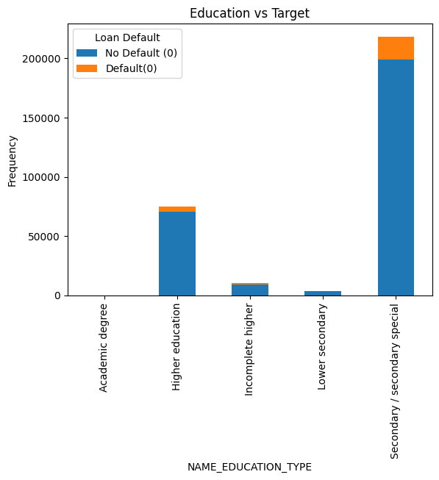
Education vs Loan Default
Default rate in Lower Secondary is 10.92% followed by secondary 8.93% and least in Academic Degree 1.82%
Individuals with lower educational qualifications (secondary education) are more likely to take loans, and also more likely to default.
Higher education appears to correlate with a lower default rate, despite the relatively high number of borrowers.

Slide 48
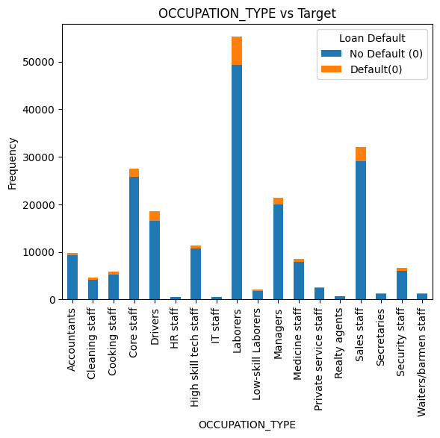
Occupation Type vs Loan Default
Default rate in Low-skill Laborers is 17.15% followed by Drivers is 11.32%
lowest in Accountants is 4.83%
Laborers are mostly likely to take loan and mostly likely to default
High skill tech staff appears to have low default rate

Slide 49
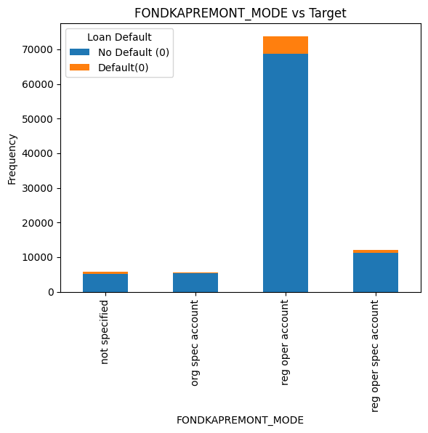
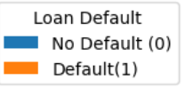
Capital Repair Fund vs Loan Default
Default rate for not specified is 7.54% followed by reg oper account 6.97% and
lowest is in org spec account 5.81%
Regular Operational Account is mostly present in the data with significant default rate due to its high presence

Slide 50
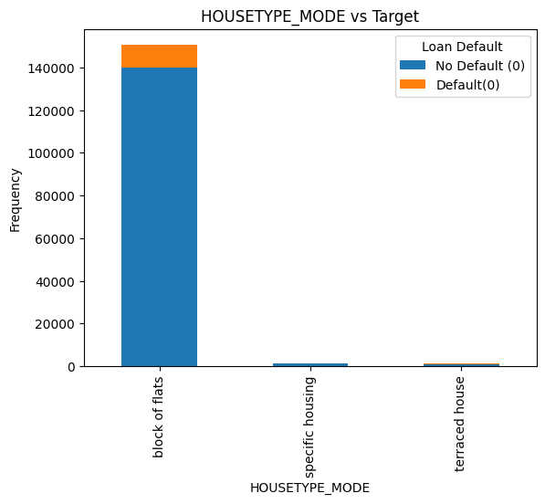
House Type Mode vs Loan Default
Most of client lives in the block of flats
Default rate for specific housing is 10.14% followed by terrace housing 8.49%
lowest in block of flats 6.94%
Notes:
A regular operation account is a business checking account used to manage a company's daily transactions.

Slide 51
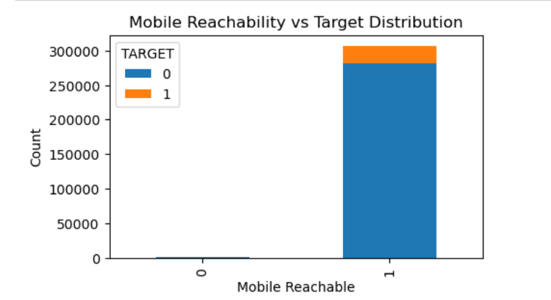
Mobile Reachability vs Loan Default
Mobile Default Group:
Represents a significant portion of defaulters 24,780 , accounting for approximately 8% of the total population.
Non-Mobile Default Group:
Represents a much smaller portion of defaulters 45, accounting for approximately 0.01% of the total population.

Slide 52
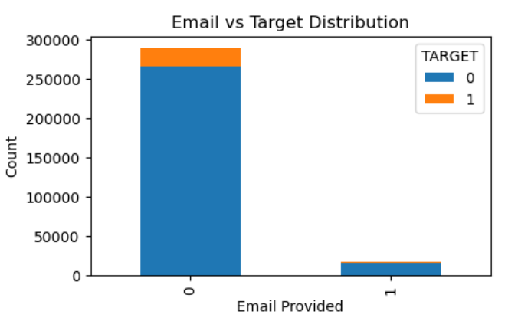
Email Ownership vs Loan Default
Non-Email Users: 8.0%, 23,451, a significant number of non-email users default, indicating potential challenges in repayment.
Email Users: 7.86%, 1374, the default rate for email users is slightly lower than that for non-email users.
The data indicates that email communication may play a positive role in borrower engagement and repayment.
Overall Default Rate:8.77%

Slide 53

Family Members vs Loan Default
The default rates for families with 1 and 2 members are relatively lower, indicating that smaller families may have fewer financial burdens or greater income stability.​
There is a slight increase in the default rate for families with 3 to 5 members. ​
The default rate peaks at 9.4% for families with 5 members,
Overall Default Rate 8.07%

Slide 54

Region Rating vs Loan Default
Clients with Region Rating 1 show the lowest default rate 5%, suggesting that borrowers in this region may have better financial stability
Clients with Region Rating 3 have the highest default rate 11%, indicating that this group is at a higher risk for defaults
Overall Default Rate 8.77%

Slide 55

Applied Day vs Loan Default
Highest Default Rate: Sunday (8.60%)
Lowest Default Rate: Monday (7.76%)
Default rates are relatively consistent across weekdays, with some fluctuation.

Slide 56

Organization Type vs Loan Default
Self-employed: Highest default rate at 10%, indicating financial instability.
Business Entity Type 3, Trade: Type 7 and Business Entity Type 2: High default rate of 9%, showing significant risk.
Government & Medicine Sector: Relatively low default rate of 7.00%, indicating reliable repayment behavior.
XNA and School: Lowest default rates at 5%, suggesting stable finances.

Slide 57

Gender, Car Ownership, and Loan Default
Females (8.63% default rate) and males (8.34% default rate) show similar default rates, with females slightly higher.
Car Owners:
Females: 5.78% default rate (2,603 defaults)
Males: 8.34% default rate (4,973 defaults)
Non-Car Owners:
Females: 7.36% default rate (11,567 defaults)
Males: 12.53% default rate (5,682 defaults)

Slide 58

Income Type , Family Status, and Loan Default

Slide 59
Commercial Associates and Pensioners display notable default rates:
Commercial Associates: Out of 70,35 total loans in civil marriage status, 682 defaults indicate a default rate of approximately 9.7%.
Pensioners: With 33,50 loans in civil marriage status, 227 defaults lead to a default rate of about 6.8%.
Stable Categories:
Businessmen and Students show no defaults across any family status, indicating strong creditworthiness in these groups.
Working individuals demonstrate the highest total loan counts and varying default rates, highlighting their crucial role in the lending landscape.
General Trends:
Married individuals generally have lower default rates across all income types, indicating stability.
The "Single / not married" category shows a mix of low defaults in Businessman and high defaults in Working, suggesting varied financial behaviors.

Slide 60

Employment Status, Car Ownership, and Loan Default
Employed Individuals:
Without Car Ownership:
Total Count: 157,717
With Car Ownership:
Total Count: 94,418
Employed individuals are more likely to have car ownership, suggesting greater financial stability.
Unemployed Individuals:
Without Car Ownership:
Total Count: 45,207
With Car Ownership:
Total Count: 10,169
A significantly lower number of unemployed individuals own cars, indicating potential financial constraints.

Slide 61

Age, Income, and Loan Default
Loan Defaults and Age: Default rates rise through the 30s, peaking at around age 34, while younger individuals (20s) show lower default rates.
Income Trends: Average income increases with age, with individuals in their 30s earning significantly more (up to $192,746 at age 34).

Slide 62




Family Status, Number of Children and Loan Default
Across all family statuses, the number of defaults tends to decrease as the number of children increases, though certain groups (e.g., married) still experience substantial default rates even with more children.

Slide 63

Housing Type, Realty Ownership and Loan Default
House/Apartment Owners: Default rate of 7.84% (15,585 defaults) for owners vs. 7.7% (5,687 defaults) for non-owners, showing minimal difference.
Co-op Apartments: Owners have a higher default rate (7.77%) compared to non-owners (8.25%), indicating financial risk is present for both.
Rented Apartments show a default rate of 14.76% for non-owners and 13.06% for owners, indicating higher vulnerability among renters.
Living with Parents: Non-owners face a default rate of 12.99%, which is notable.

Slide 64

Name Type Suite, Income Type and Loan Application
Income Type Variability: Income types like "Commercial associate" and "Working" show significant counts across various suite types, especially for "Unaccompanied," indicating a higher risk associated with these categories.
Family Structure Impact: The "Family" suite has high counts for "Commercial associate," but notably lower for "Maternity leave," suggesting that certain family structures may correlate with more stable financial situations.

Slide 65

Region Rating, Housing Type and Loan Application
The "House / apartment" category consistently shows the highest counts across all region ratings, particularly in Region 2, suggesting that it's the most common housing type among clients.
In Region 1, "Co-op apartment" has a relatively low count, indicating it might be less associated with lower financial risk

Slide 66

Document Count and Loan Default
Document Importance:
The presence of documents generally correlates with lower loan default rates, particularly with larger family sizes, suggesting that documentation may be a factor in securing loans effectively.

Slide 67
Analysis On Previous Application

Slide 68

Previous Loan Purpose Distribution
"XAP" and "XNA" dominate the loan purposes, with "XAP" having 55%, and "XNA" close behind with 40%
.Other categories like "Repairs," "Other," and "Urgent needs" have very small applicants in comparison,
Most previous loans fall under the categories "XAP" and "XNA,"

Slide 69

Previous Loan Type Distribution
Cash loans are the most common type, with 45% applicants, indicating that they are highly preferred.
Consumer loans follow closely with 44% applicants, suggesting a similar demand as cash loan.
Revolving loans, with 12% applicants, are significantly less common than cash and consumer loans.

Slide 70

Previous Payment Channel Distribution
With 62% applicants, the majority of loans are disbursed as cash through the bank, indicating a strong preference for direct cash payouts.
There are 38% cases labeled as "XNA," meaning the disbursement method is either unknown or not provided for those loans.
Only 0.5% loans are disbursed through non-cash methods directly from the borrower's account,
Cash through the bank is the most common payment method, with 62% transactions, indicating a strong preference.
XNA follows closely with 37% transactions, showing it's a popular alternative.
Non-cash from your account, with 8,193, (0.5%) transactions, is far less common.

Slide 71

Payment method distribution
Cash through bank is the most prominent method 61.9% used
Payment method is not available for 37.6%
Notes:
A cash loan is a short-term loan that provides access to cash for immediate needs. Cash loans can be used for a variety of purposes, such as paying medical expenses, education fees, or home renovations
A consumer loan is a financial agreement between a customer and a financial institution that allows the customer to borrow money to purchase goods and services.
A revolving loan, also known as a revolving credit facility or revolver, is a type of loan that allows a borrower to withdraw, repay, and withdraw again up to a set limit. Revolving loans are different from traditional loans because they don't have fixed repayment terms. Instead, borrowers can draw funds as needed and repay them when it's convenient.

Slide 72

Loan Rejection Reason Distribution
XAP Reject code is not applicable for 81% of application i.e for approved and cancelled application
The second largest category is HC, with 10.5% applicants, possibly indicating loans reviewed under specific high-priority or high-value conditions.
LIMIT has 3.3%, while SCO has 2.2%. These might represent loans approved with specific limits or scored under certain criteria, showing moderate representation

Slide 73

Applicant Status Distribution
Repeater 74%: Highest value, suggests primary focus or significance.
New 18%: Lower, indicates a niche area or less frequent occurrence.
Refreshed 8%: Intermediate, may represent updates or modifications.
XNA 0.1%: Lowest, likely the least significant term.

Slide 74

Previous Product Type Distribution
XNA 64%
This is the highest value, indicating that "XNA" has become a significant category.
X-sell 27%
This term is notably lower but substantial, suggesting it represents a key area, possibly related to upselling or cross-selling.
Walk-in 9%
This is the lowest value, indicating that "Walk-in" might represent a less frequent occurrence

Slide 75

Previous Acquisition Channel Distribution
Credit and cash offices (45%): Dominant channel, crucial for traditional in-person transactions.
Country-wide (31%): Significant national reach, driving broad accessibility.
Stone (13%): Notable but may need contextual relevance to enhance impact.
Regional / Local (7%): Supports local operations, complementing national efforts.
Contact center & AP+ (Cash Loan) (4%): Moderate contributor with potential for growth.

Slide 76

Previous Seller Industry Distribution
XNA 51%: Highest value; primary focus area with significant importance.
Consumer Electronics 24%: Substantial category; likely a key revenue driver.
Connectivity 17% : Important segment; suggests growing demand for connectivity solutions.
Furniture 4% & Construction 2%: Lower emphasis; could represent an area for growth.
Clothing & Industry1% : Less prominent; further investigation could identify opportunities.

Slide 77

Types of Loan Distribution
Cash loans are the most common type of loan, with a count 747,553
Consumer loans follow closely behind, with a count 729,151
Revolving loans are much less common in comparison, having count of 193,164
Notes:
A cash loan is a short-term loan that provides access to cash for immediate needs. Cash loans can be used for a variety of purposes, such as paying medical expenses, education fees, or home renovations
A consumer loan is a financial agreement between a customer and a financial institution that allows the customer to borrow money to purchase goods and services.
A revolving loan, also known as a revolving credit facility or revolver, is a type of loan that allows a borrower to withdraw, repay, and withdraw again up to a set limit. Revolving loans are different from traditional loans because they don't have fixed repayment terms. Instead, borrowers can draw funds as needed and repay them when it's convenient.

Slide 78

Contract Status Distribution
Approved application were 62.1% with a count of 1,036,781
Cancelled application were 18.9% with a count of 316,319
Refused application were 17.4% with a count of 290,678
Unused offer were 1.6% with a count of 26,436
Notes:
A cash loan is a short-term loan that provides access to cash for immediate needs. Cash loans can be used for a variety of purposes, such as paying medical expenses, education fees, or home renovations
A consumer loan is a financial agreement between a customer and a financial institution that allows the customer to borrow money to purchase goods and services.
A revolving loan, also known as a revolving credit facility or revolver, is a type of loan that allows a borrower to withdraw, repay, and withdraw again up to a set limit. Revolving loans are different from traditional loans because they don't have fixed repayment terms. Instead, borrowers can draw funds as needed and repay them when it's convenient.

Slide 79

Decision Made Distribution
Most of the decision were taken in first two year
Notes:
A cash loan is a short-term loan that provides access to cash for immediate needs. Cash loans can be used for a variety of purposes, such as paying medical expenses, education fees, or home renovations
A consumer loan is a financial agreement between a customer and a financial institution that allows the customer to borrow money to purchase goods and services.
A revolving loan, also known as a revolving credit facility or revolver, is a type of loan that allows a borrower to withdraw, repay, and withdraw again up to a set limit. Revolving loans are different from traditional loans because they don't have fixed repayment terms. Instead, borrowers can draw funds as needed and repay them when it's convenient.

Slide 80

Accompanied Client Distribution
Application that were unaccompanied was 59.9% with count of 508,970
Application that were accompanied with Family was 25.1% with count of 213,263
Application that were accompanied with Spouse, partner was 7.9% with count of 67,069
Application that were accompanied with children, partner was 3.7% with count of 31,566
Notes:
A cash loan is a short-term loan that provides access to cash for immediate needs. Cash loans can be used for a variety of purposes, such as paying medical expenses, education fees, or home renovations
A consumer loan is a financial agreement between a customer and a financial institution that allows the customer to borrow money to purchase goods and services.
A revolving loan, also known as a revolving credit facility or revolver, is a type of loan that allows a borrower to withdraw, repay, and withdraw again up to a set limit. Revolving loans are different from traditional loans because they don't have fixed repayment terms. Instead, borrowers can draw funds as needed and repay them when it's convenient.

Slide 81

Client Type Distribution
We have 73.7% repeater type client with a count of 1,231,261
New client are 18% with a count of 301,363
Refreshed client are 8.1 with a count of 135,649
Notes:
A cash loan is a short-term loan that provides access to cash for immediate needs. Cash loans can be used for a variety of purposes, such as paying medical expenses, education fees, or home renovations
A consumer loan is a financial agreement between a customer and a financial institution that allows the customer to borrow money to purchase goods and services.
A revolving loan, also known as a revolving credit facility or revolver, is a type of loan that allows a borrower to withdraw, repay, and withdraw again up to a set limit. Revolving loans are different from traditional loans because they don't have fixed repayment terms. Instead, borrowers can draw funds as needed and repay them when it's convenient.

Slide 82

Type of Goods Distribution
What Kind of goods did the client apply loan for is not available for 56.9%
For mobile 13.5% of client applied loan
For consumer electronics 7.3% of client applied
For computers 6.3% ,Audio/Video 6.0% ,Furniture 3.2%, Photo/Cinema Equipment 1.5%
Notes:
A cash loan is a short-term loan that provides access to cash for immediate needs. Cash loans can be used for a variety of purposes, such as paying medical expenses, education fees, or home renovations
A consumer loan is a financial agreement between a customer and a financial institution that allows the customer to borrow money to purchase goods and services.
A revolving loan, also known as a revolving credit facility or revolver, is a type of loan that allows a borrower to withdraw, repay, and withdraw again up to a set limit. Revolving loans are different from traditional loans because they don't have fixed repayment terms. Instead, borrowers can draw funds as needed and repay them when it's convenient.

Slide 83


Channel Distribution
Top Channel is Credit and cash offices which acquired 43.1% of client
Next is Country Wide which acquired 29.6% of client
Notes:
A cash loan is a short-term loan that provides access to cash for immediate needs. Cash loans can be used for a variety of purposes, such as paying medical expenses, education fees, or home renovations
A consumer loan is a financial agreement between a customer and a financial institution that allows the customer to borrow money to purchase goods and services.
A revolving loan, also known as a revolving credit facility or revolver, is a type of loan that allows a borrower to withdraw, repay, and withdraw again up to a set limit. Revolving loans are different from traditional loans because they don't have fixed repayment terms. Instead, borrowers can draw funds as needed and repay them when it's convenient.

Slide 84

Grouped Interest Rate Distribution
Grouped interest rate is not available for 31% of application
Middle interest were applied on 23.1% of application
High interest rate is applied on 21.2% of application
Notes:
A cash loan is a short-term loan that provides access to cash for immediate needs. Cash loans can be used for a variety of purposes, such as paying medical expenses, education fees, or home renovations
A consumer loan is a financial agreement between a customer and a financial institution that allows the customer to borrow money to purchase goods and services.
A revolving loan, also known as a revolving credit facility or revolver, is a type of loan that allows a borrower to withdraw, repay, and withdraw again up to a set limit. Revolving loans are different from traditional loans because they don't have fixed repayment terms. Instead, borrowers can draw funds as needed and repay them when it's convenient.

Slide 85

Previous Application Annuity Distribution
Highly Skewed Distribution: The annuity distribution is heavily right-skewed, indicating that most annuity amounts are quite low, with a few larger annuities stretching out to the right.
Majority of Annuities Under 100,000: The bulk of the annuities seem to be clustered below 100,000, with a massive spike around very low values, suggesting that small annuities are far more common.
Notes:
A cash loan is a short-term loan that provides access to cash for immediate needs. Cash loans can be used for a variety of purposes, such as paying medical expenses, education fees, or home renovations
A consumer loan is a financial agreement between a customer and a financial institution that allows the customer to borrow money to purchase goods and services.
A revolving loan, also known as a revolving credit facility or revolver, is a type of loan that allows a borrower to withdraw, repay, and withdraw again up to a set limit. Revolving loans are different from traditional loans because they don't have fixed repayment terms. Instead, borrowers can draw funds as needed and repay them when it's convenient.

Slide 86

Previous Application Amount Distribution
Highly Skewed Distribution: The amount distribution is heavily right-skewed, indicating that most amounts are quite low, with a few larger amount stretching out to the right.
Majority of Amount Under 1,000,000: The bulk of the amount seem to be clustered below 1,000,000, with a massive spike around very low values, suggesting that small amount are far more common.
Notes:
A cash loan is a short-term loan that provides access to cash for immediate needs. Cash loans can be used for a variety of purposes, such as paying medical expenses, education fees, or home renovations
A consumer loan is a financial agreement between a customer and a financial institution that allows the customer to borrow money to purchase goods and services.
A revolving loan, also known as a revolving credit facility or revolver, is a type of loan that allows a borrower to withdraw, repay, and withdraw again up to a set limit. Revolving loans are different from traditional loans because they don't have fixed repayment terms. Instead, borrowers can draw funds as needed and repay them when it's convenient.

Slide 87

Previous Credit Amount Distribution
Highly Skewed Distribution: The credit amount distribution is heavily right-skewed, indicating that most credit amounts are quite low, with a few larger amount stretching out to the right.
Majority of Credit Amount Under 1,000,000: The bulk of the amount seem to be clustered below 1,000,000, with a massive spike around very low values, suggesting that small amount are far more common.
Notes:
A cash loan is a short-term loan that provides access to cash for immediate needs. Cash loans can be used for a variety of purposes, such as paying medical expenses, education fees, or home renovations
A consumer loan is a financial agreement between a customer and a financial institution that allows the customer to borrow money to purchase goods and services.
A revolving loan, also known as a revolving credit facility or revolver, is a type of loan that allows a borrower to withdraw, repay, and withdraw again up to a set limit. Revolving loans are different from traditional loans because they don't have fixed repayment terms. Instead, borrowers can draw funds as needed and repay them when it's convenient.

Slide 88

Contract Type Vs Contract Status
Approval rate for Consumer loans is 85.91% followed by Revolving loans is 50.65% and least is for Cash Loans 41.80%
Most approved contract type is Consumer loan
Most unused contract type is consumed loan
Most cancelled contract type is cash loan followed by revolving loan
Notes:
A cash loan is a short-term loan that provides access to cash for immediate needs. Cash loans can be used for a variety of purposes, such as paying medical expenses, education fees, or home renovations
A consumer loan is a financial agreement between a customer and a financial institution that allows the customer to borrow money to purchase goods and services.
A revolving loan, also known as a revolving credit facility or revolver, is a type of loan that allows a borrower to withdraw, repay, and withdraw again up to a set limit. Revolving loans are different from traditional loans because they don't have fixed repayment terms. Instead, borrowers can draw funds as needed and repay them when it's convenient.

Slide 89

Purpose of Cash Loan Vs Contract Status
Approval rate for XAP is 78.49% followed by Purchase of electronic equipment is 55.41% and least is for Payments on other loans 15.74%
The purpose of Cash Loan is not applicable or not available of majority of data
Approval rate for XAP is more than XNA
Notes:
A cash loan is a short-term loan that provides access to cash for immediate needs. Cash loans can be used for a variety of purposes, such as paying medical expenses, education fees, or home renovations
A consumer loan is a financial agreement between a customer and a financial institution that allows the customer to borrow money to purchase goods and services.
A revolving loan, also known as a revolving credit facility or revolver, is a type of loan that allows a borrower to withdraw, repay, and withdraw again up to a set limit. Revolving loans are different from traditional loans because they don't have fixed repayment terms. Instead, borrowers can draw funds as needed and repay them when it's convenient.

Slide 90

Client Type Vs Contract Status
Approval rate for New is 93.32% followed by Refreshed is 71.58% and least is for XNA 29.77%
As we know 73.7% of client is repeat customer
Hence for Repeat customer we see prominent approval , cancelation and refusal rate
Negligible Cancellation/Refusal rate for New and Refreshed client due to their low proportion in the data
Notes:
A cash loan is a short-term loan that provides access to cash for immediate needs. Cash loans can be used for a variety of purposes, such as paying medical expenses, education fees, or home renovations
A consumer loan is a financial agreement between a customer and a financial institution that allows the customer to borrow money to purchase goods and services.
A revolving loan, also known as a revolving credit facility or revolver, is a type of loan that allows a borrower to withdraw, repay, and withdraw again up to a set limit. Revolving loans are different from traditional loans because they don't have fixed repayment terms. Instead, borrowers can draw funds as needed and repay them when it's convenient.

Slide 91

Goods Category Vs Contract Status
Approval rate for Animals is 100% followed by Fitness is 99.04% and least is for House Construction 0%
What kind of goods did the client applied for is not available and there contribution is very high and hence they have higher cancellation, refusal and approval rate
Notes:
A cash loan is a short-term loan that provides access to cash for immediate needs. Cash loans can be used for a variety of purposes, such as paying medical expenses, education fees, or home renovations
A consumer loan is a financial agreement between a customer and a financial institution that allows the customer to borrow money to purchase goods and services.
A revolving loan, also known as a revolving credit facility or revolver, is a type of loan that allows a borrower to withdraw, repay, and withdraw again up to a set limit. Revolving loans are different from traditional loans because they don't have fixed repayment terms. Instead, borrowers can draw funds as needed and repay them when it's convenient.

Slide 92

Interest Rate Vs Contract Status
Approval rate for High is 84.62% followed by middle is 83.78% and least is for XNA is 18.90%
We see very few low_action interest rate gets approved
Some approved contract does not have interest rate defined
High, middle, low normal have nearly equal contribution in approved contract
Notes:
A cash loan is a short-term loan that provides access to cash for immediate needs. Cash loans can be used for a variety of purposes, such as paying medical expenses, education fees, or home renovations
A consumer loan is a financial agreement between a customer and a financial institution that allows the customer to borrow money to purchase goods and services.
A revolving loan, also known as a revolving credit facility or revolver, is a type of loan that allows a borrower to withdraw, repay, and withdraw again up to a set limit. Revolving loans are different from traditional loans because they don't have fixed repayment terms. Instead, borrowers can draw funds as needed and repay them when it's convenient.

Slide 93

Dashboards

Slide 94


Slide 95


Slide 96


Slide 97


Slide 98

Predictive Modelling

Slide 99

Agenda

Slide 100
Business Problem -
The goal is to identify patterns that indicate a higher risk of default, which can inform actions such as denying the loan, reducing the loan amount, or charging higher interest rates to risky applicants with the help of predictive modelling. By doing so, lenders can better ensure that only creditworthy consumers receive loans.
About Data -
application_data.csv It contain about 122 columns and 307511 records and contain
all information that are related to client. (like -Loan Information,Client Demographics,Document Information,Credit Bureau Inquiries etc.)

Slide 101

Data Cleaning-

Slide 102

Data Cleaning-
Note : After cleaning , The final data in table contains about 64 columns and 307511 records.

Slide 103

Data Preprocessing -

Slide 104

Logistic Regression-

Slide 105

Random Forest Classifier -

Slide 106

Importance Of Variables -

Slide 107


Model-01 -
With Logistic Regression Classification Report -

Slide 108



Model-02 -
With Random Forest Classification Report -

Slide 109
Interpretation For Model 01 & 02 -
High Performance for Class 0: The model performs very well in identifying non
default cases (Class 0), with high precision, recall, and F1-score.
High Performance for Class 0: The model performs very well in identifying non-default cases (Class 0), with high precision, recall, and F1-score.
Poor Performance for Class 1: The model fails to identify any default cases (Class 1), as indicated by the precision, recall, and F1-score being zero. This indicates a potential issue with model bias, likely favoring the majority class.
Overall Accuracy: While the overall accuracy is high (92%), it can be misleading due to the class imbalance in the dataset.

Slide 110


Using Random Sampling Approach -
Using random sampling because the dataset are present into imbalance form . Random sampling will pick the same number of records from class 0
Before Random Sampling
After Random Sampling

Slide 111


Model-03 -
With Logistic Regression Classification Report -

Slide 112


Model-04 -
With Random Forest Classification Report -

Slide 113



Slide 114
Interpretation For Model 03 & 04 -
Balanced Performance: The model demonstrates balanced performance across both classes, with precision, recall, and F1-scores all at 0.65 for both Class 0 and Class 1.
Moderate Accuracy: The overall accuracy is also 0.65, indicating that the
model is correctly predicting around 65% of the instances.
Recommendation -
Threshold Optimization: Experiment with adjusting the classification threshold to improve precision or recall based on specific business needs.

Slide 115


